Slide 1
Garbage Classification using Deep Learning

Slide 2
Project Layout
Phase 1 – Data Preparation & Preprocessing
• Load & explore dataset of garbage images
• Resize and normalize images
• Apply data augmentation and split into train/val sets
Phase 2 – Model Building & Training
• Load EfficientNetV2B2 with ImageNet weights
• Add custom dense layers for classification
• Use callbacks (EarlyStopping, ReduceLR), compute class weights
Phase 3 – Deploy with Gradio UI
• Create prediction function
• Build interactive UI using Gradio Interface

Slide 3
Tools & Technologies
• Python (Programming Language)
• TensorFlow/Keras (Deep Learning Framework)
• EfficientNetV2B2 (Pre-trained Model)
• Gradio (Web-based UI for models)
• NumPy, Matplotlib, Seaborn (Data manipulation & visualization)
• Jupyter Notebook (Development Environment)

Slide 4
Technical Architecture
• Input image from user via Gradio
• Image preprocessing: resize, normalize
• Model predicts class probabilities
• Gradio UI displays most likely class.

Slide 5
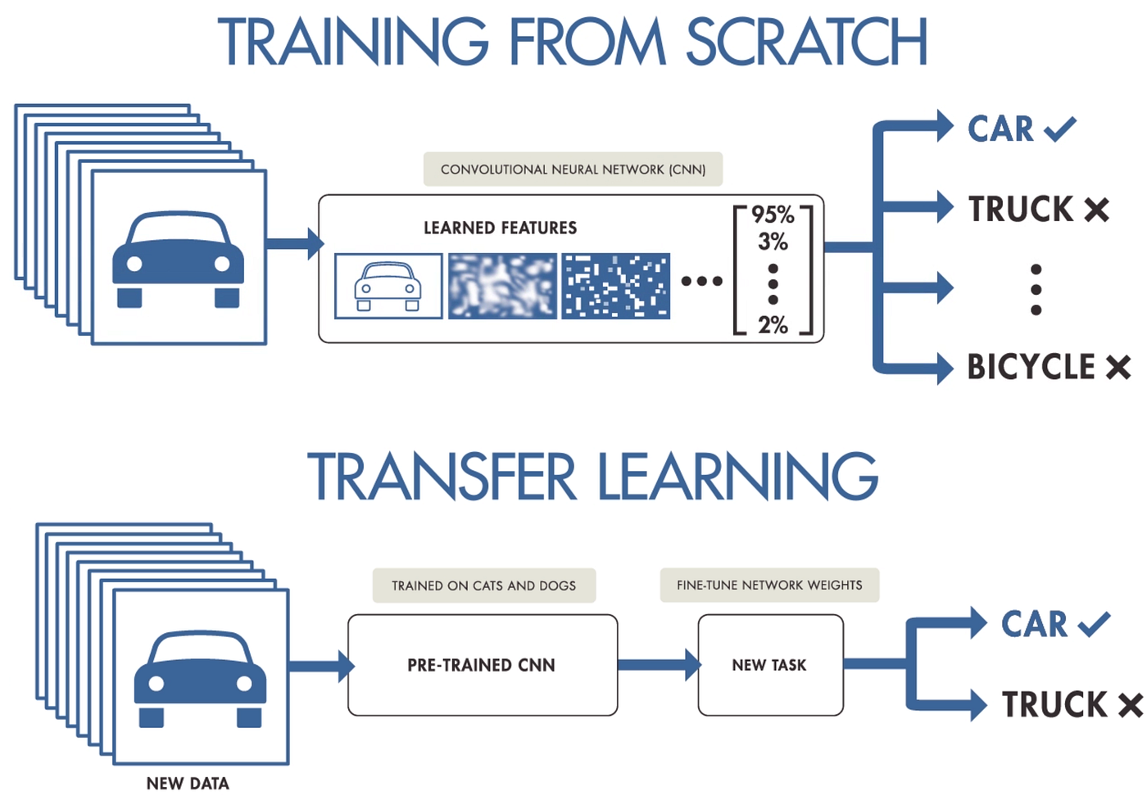


Slide 6
Improvement Potential / Next Steps
• Expand dataset to include more classes and edge cases
• Optimize model for mobile or embedded devices
• Improve accuracy with ensemble models
• Add real-time webcam integration for live detection
• Log predictions and confidence for feedback loop
• Add authentication layer to UI

Slide 7
Summary
• Built a smart garbage classifier using EfficientNetV2B2
• Achieved high accuracy using transfer learning
• Created interactive web app with Gradio
• Project is modular, scalable, and easy to extend
Thank You!

